Slide 1


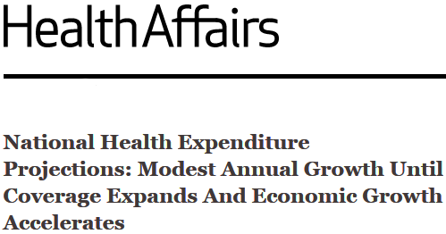
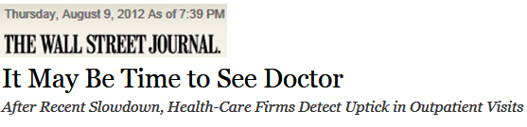
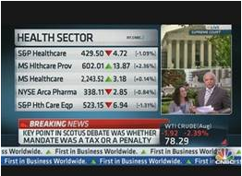


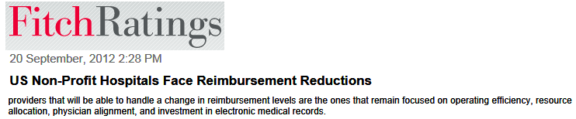

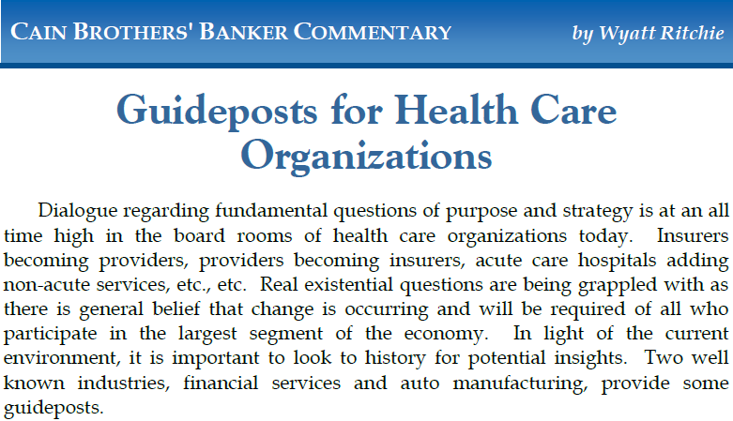
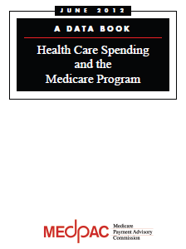
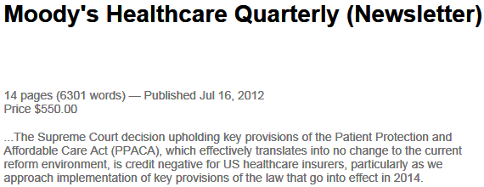
Challenge and Response … using your experience to steer direction

Slide 2
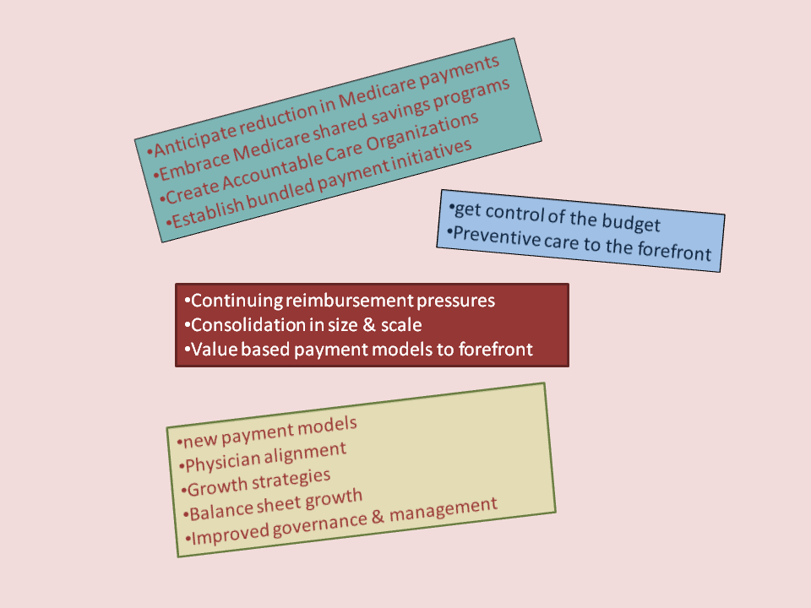

Managing Ambiguity
… using internal experiential encounter data to steer direction

Slide 3
Industry Opinions (external)
Anticipate reduction in Medicare payments
Embrace Medicare shared savings programs
Create Accountable Care Organizations
Establish bundled payment initiatives
Investment Banker
Continuing reimbursement pressures
Consolidation in size & scale
Value based payment models to forefront
Fitch Ratings
get control of the budget
Preventive care to the forefront
US Comptroller
new payment models
Physician alignment
Growth strategies
Balance sheet growth
Improved governance & management
Moody’s

Slide 4
Future Expectations
external opinions
inside the industry
Industry Transformation
  reduce variability
  manage risk
    different trend lines
    rethinking service line management
Comprehending Past Trends via data points
  drilling down within the patient discharge record to:
    comprehend and manage risk
    manage clinical protocol compliance
    create relevant benchmarks to gauge performance

Slide 5

different Trend Lines

Slide 6
Industry Opinions (external)
Reform creates urgency
sense of effectiveness required
Capital costs are inherent in change
builds facility experience
population management skills more important than controlling the dollars
Organizational Development & Restructuring are required with strategic decisions in order to survive

Slide 7
From Here to There by Finding Your Data Points
Avoid unintended consequences
Create a comprehensive discharge database. The database will have 100+ discreet data elements about the patient encounter.
Recast top down analyses the provider needs detailed information and a tool to get at (manipulate) the data.
Acquire external database of regional facility discharges, duplicate report formats with clustered facility results.
Medical Management Analyses

Slide 8
Industry Opinions (inside)
Everything is interrelated; changing behaviors is paramount
Manage Risk
Creating an ACO (controlling the dollars) is attractive; but requires population skills many providers have not demonstrated
High quality\low cost is difficult; requires responsibility for entire episode of care even when beyond walls of provider. Reducing deviation in process is crucial.
IT Infrastructure
Implementation of EHR can be disruptive; will benefits (meaningful use) be demonstrated.
Relationship Building
Incentive reimbursements will test durability of provider partnerships; care is a continuum process. Will specialists produce quality performance measures.
Engage patients in their care management

Slide 9
Difficult Strategy Issues
… everything is related
New payment models
Decreased physician visits
Competition for particular physician specialists
  Compensation plan types
Questions re appropriate care
  Readmission penalties
  Implement standardized care management protocols
  Adverse Events
Healthcare is becoming discretionary
HER can be disruptive to a physician practice
Ability to report performance measures
Transparency and cooperation between providers & insurers
Precedes financial analyses and simulations
Know your past

Slide 10
Finding Your Data Points: Discharge Record - extended
the patient encounter

Slide 11
Discharge Record – part 2
sifting thru -- from Admit to Discharge

Slide 12
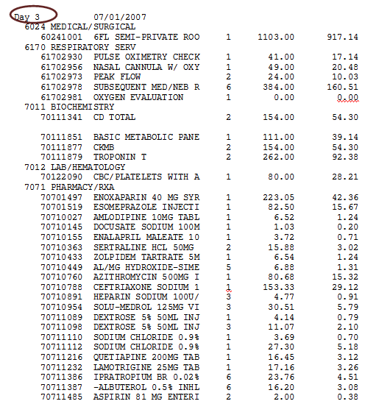
Managing Risk – care protocols
Identifying resource consumption is important not just to minimize costs but for identifying and modifying staff behaviors -- while still achieving optimum outcomes

Slide 13
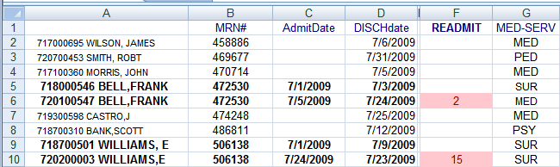
Managing Risk- locating readmissions
… staff protests aside, locating readmissions can be achieved within a spreadsheet by appropriately sorting discharges using conditional formatting report features.

Slide 14
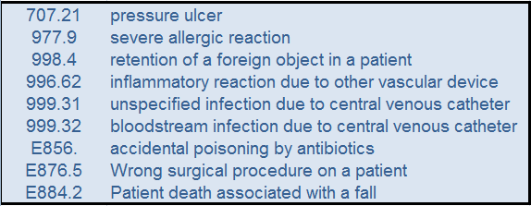
Managing Risk- adverse events
Payment denials due to patient harm is the new normal

Slide 15
Finance -Physician Integration-Compensation
How Has the Rise of Physician Employment Changed Hospitals' Recruitment Strategies? Becker’s Hospital Review
The appeal of hospital employment to physicians is no secret. Upon completion of their training, more physicians are looking to work in either larger, independent group or hospital-owned practices, whether for financial reasons, lifestyle preferences or a combination of the two. The number of independent physicians, or providers with a financial stake in their practice, shrunk from 57 percent in 2000 to 39 percent in 2012 and a projected 36 percent in 2013, according to data from Accenture.
In the latest annual Residents and Fellows Survey conducted by Cejka Search, 46 percent of respondents from medical schools' 2012 graduating classes said group practices were the ideal choices, while 29 percent said hospital-affiliated practices were most preferred. And interest in employment is not restricted to fresh-faced residency graduates, either. Many established physicians in private practice are losing interest in entrepreneurship and the risks associated with it.
"The fact that established physicians also want to become employed has changed hospitals' attitudes toward recruitment," says Max Reiboldt, CPA, president and CEO of healthcare consulting firm Coker Group.
These findings suggest a natural and progressive physician exodus from private practice into group practices and health systems, begging the question of whether physician recruitment is still imperative to hospitals these days.
Straight salary
Equal shares
Productivity based comp
Incentive based comp
Capitation

Slide 16
Finance – ACO Development
Multi-year relationship with insurer to re-engineer care processes; sharing information re ER visits and readmissions
Improve Service Line Management that targets and manages chronic disease conditions
Acquire benchmarks (eg HEDIS, NFQ) to measure performance and provide plausibility
Prepare for government payment innovation

Slide 17
Finance
Physician Integration
IT Infrastructure
Partnership Building
Quality
Clinical protocol development
Effective MU communication
Reducing Care Variability
Use HEDIS & NFQ measurements
Measurement
-clinical protocol compliance
Physician profiling
Service Trends
Expand BI via EHR implementation
Risk
Population Management
Minimize Variability
Chronic Disease Management
Reimbursement Distributions
Staying Mission Focused – by connecting the dots

Slide 18

Brian Rucco collaborates with healthcare providers, insurers and industry watchdog organizations producing fact based insights about rapidly changing local healthcare environments. Business Intelligence analyses have helped clients better manage risk, understand disruptive innovation and locate root cause issues through data driven analyses.

